Slide 1

Back to School 2015-2016
Mrs. Abbott’s Classroom

Slide 2




PROCEDURES
Entering the Classroom
  Enter quietly
  Pick up papers from back counter
  Turn in homework!
  Sharpen pencils, make sure you have all supplies
  Check the board for any instructions
  Get busy on “Bell Ringer” activity!
Bags and Back Packs
  Hang them on the back of your chair
Personal Space
  Keep all of your belongings out of other people’s way
  Keep the aisles clear so that no one trips over your stuff!

Slide 3


PROCEDURES
Pencils / Pens / Paper
  You MUST have these supplies with you EVERY DAY!!
  You may OCCASIONALLY borrow paper or a writing utensil from me, but you must use a pass to do so. HOWEVER--I am not responsible for YOUR school supplies!
During Class
  Work quietly at your own desk, unless you are asked to participate in a group activity.
Asking Questions
  Raise your hand to ask / answer a question and wait until called upon unless I tell you to shout out the answer.
Turning In Work
  Each class has a designated bin for turning in work. To avoid any confusion, please make sure you put your papers in the correct bin!
  Your paper may be counted late if it is misplaced or lost because you didn’t put it in the right bin!
  Papers should be stacked neatly, each facing the same direction.

Slide 4



PROCEDURES
When Work is Finished
  You must be doing SOMETHING!
  You may read or write
  You may work on an assignment for another class, but ONLY if you finish the assignments for THIS class first!
Leaving the Classroom
  You may not leave the classroom until the bell rings, unless you have a pass from the teacher.
  Unless it’s an emergency, drinks and restroom must be taken care of between classes.
When Class is Over
  Class is not over until I dismiss you!!!
  Make sure you have everything you need to complete your homework!

Slide 5



SUPPLIES
When you come to class, you MUST have paper, pencil OR black or blue erasable pen, and red grading pen.
You must have your binder for each class. Text books will be left in the classroom until needed.
You also need a composition book for class. You may purchase them from me for 50 cents.
You will be subject to disciplinary action if you do not have your supplies when you come to class.
You will receive a free daily grade of 100 if you have all your supplies by September 8th

Slide 6
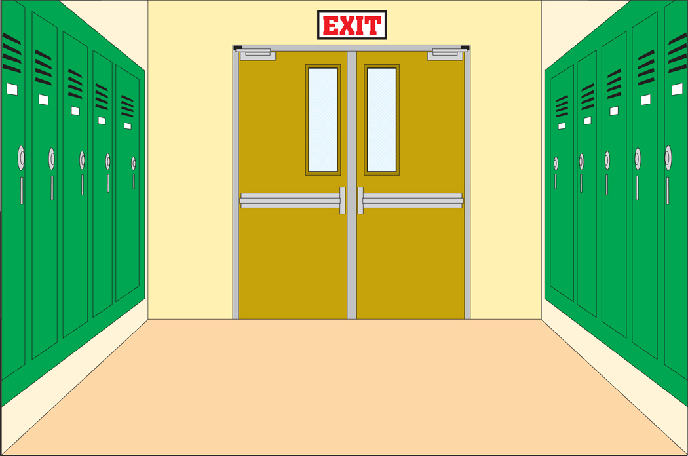




HALLWAY PROCEDURES
Always have a hall pass
Take care of business between classes!!!
  Stop at your locker and get everything you need.
  DO NOT use anyone else’s locker.
  Use the restroom and get a drink on your way down the hall.
No horseplay in the hallway!
No meandering and lollygagging!
Get to class on time!

Slide 7

END OF CLASS
Work until the bell rings.
Make sure you know your homework assignment, and record it in your planner.
Class is over when I dismiss you.
Leave the classroom in an orderly manner—don’t run over anyone!

Slide 8

EXPECTATIONS
“That’s the Way to Be”
Be respectful to yourself and others
Be kind
Be prepared
Be responsible
Be positive
Be courteous and helpful
Be a productive and cooperative member of our classroom community
Keep hands, feet, and objects to yourself
Treat others the way you want to be treated

Slide 9

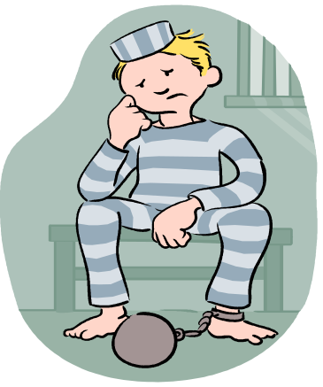

CONSEQUENCES
Any disciplinary referral can lead to:
Lunch detention
Detention (“D-Hall”)
Swats
Extra assignment
Parent Contact

Slide 10

You will be written up for:
Gum
Unauthorized cell phone activity
Dress code violations
Rude behavior
Showing disrespect to me or any other teacher
Any violation of the code of conduct as stated in the student handbook.

Slide 11

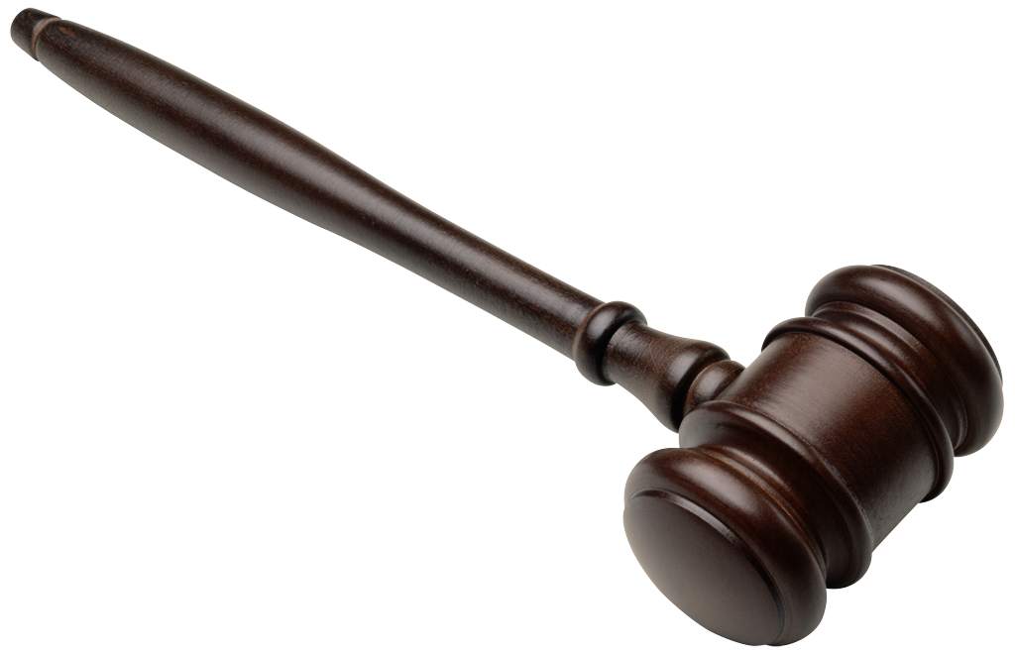
Discipline Policy
· The student will be required to complete documentation for each offense including date and specific details of misbehavior.
· Discipline and penalties will be guided by the Student Code of Conduct as outlined in the Student Handbook and handled on a case-by-case basis.*
  First Offense: Warning
  Second Offense: Parent Contact and Lunch Detention
  Third Offense: Parent Contact and Office Referral
  Each Subsequent Offense: Office Referral
*Major offenses will be referred directly to the office.

Slide 12
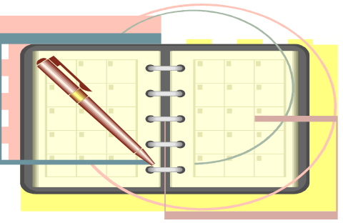
PLANNER
You will be given a student planner so that you can make plans and write down your homework for each class.
PLEASE USE YOUR PLANNER TO HELP YOU STAY ORGANIZED!

Slide 13

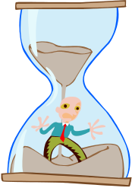
PASSES
You will receive two passes at the beginning of each 6-weeks period.
Passes give you “Just One More Day” to turn in an assignment.
Passes are also your only chance to leave class for the restroom, to retrieve a forgotten item from your locker, or to borrow supplies from Mrs. Abbott!
Passes must be filled out correctly, in ink, on the day they are issued—otherwise, they may not be used.
Passes may not be used on projects or major assignments!

Slide 14


HOMEWORK
Homework is usually given when assignments are not finished during class time.
Expect to have assigned outside reading and writing.
Expect to work on projects outside of class.
Homework assignments are due at the beginning of class.

Slide 15

GRADING POLICY
7th Reading Classes
Reading project /A-R 20%*
Daily Grades / Homework 45%
Tests / Compositions 35%
7th English Classes
Response Journals 20%
Daily Grades / Homework 45%
Tests / Compositions 35%
8th ELA / Reading Classes
Reading project /A-R 20%*
Daily Grades / Homework 45%
Tests / Compositions 35%

Slide 16
GRADING POLICY
*Students will complete and present an independent reading project at the end of each six-weeks period. Students will be able to choose from a list the book they would like to read, as well as the type of project they would like to complete. Students will take an AR test over the book they have chosen, which will be part of the project grade. Students may earn additional grade points for taking additional AR tests if they choose to read additional books during the six-weeks. Students should also expect to complete and present projects over each novel that we read as a class.
Students should expect to complete and present projects over each novel that we read as a class, as well as individual projects over novels read outside of class.
  The lowest grade in the Daily Grades category will be dropped each six-weeks.

Slide 17




IN MRS. ABBOTT’S CLASS…
YOU ONLY HAVE TO WRITE ON THE DAYS YOU EAT!

Slide 18

STUDENT HANDBOOK
Make sure you and your parents sign the signature page in your handbook, and that you turn it in to one of your teachers or to the office.

Slide 19

LATE WORK (p.63)
All work is due when the teacher calls for it. Any work turned in after that will be considered late.
Late work turned in the same day or the following day will receive a grade equal to 75% of the grade originally earned on the assignment.
Late work not turned in by the day following the original due date will receive a grade of zero.
Remember that a pass may be used to give you an extra day if you are unable to turn in an assignment on the day it is due.

Slide 20

Missing Work Policy
Student will be required to complete documentation including date and reason work was not completed.
Determination of late work will be as outlined in the Student Handbook. (p. 63)
Use of a pass allows one extra day before the assignment is deemed late.
Once an assignment has been given a grade of zero, the following will occur:

Slide 21


First Offense: Warning
(The lowest daily grade in the grade book is always dropped. Student will be allowed to complete a composition with additional points deducted for each additional day the assignment is late. No late projects will be accepted.)
Second Offense: Grade of Zero, Parent Contact, Mandatory ELA Tutorial
Third Offense: Grade of Zero, Parent Contact, Mandatory ELA Tutorial, Lunch Detention
Each Subsequent Offense: Grade of Zero, Parent Contact, Mandatory ELA Tutorial, Office Referral

Slide 22


ABSENCES AND TARDIES (p.17)
Please bring a note from the doctor if you are absent for a medical reason.
You must have a doctor’s excuse or a note from your parents when you return from any absence. Otherwise, your absence will be unexcused.
By law, students are required to attend school. (p. 19)
Students who arrive in class after the tardy bell has rung, without making prior arrangements with me, will be considered tardy and must get an admit slip from the office.
If you know ahead of time that you will be absent, please make arrangements to receive your work beforehand.
Excessive absences and /or tardies can result in the student having to attend Saturday School, according to the district attendance policy.

Slide 23

MAKE-UP WORK (p.63)
Make-up work will be handled according to the guidelines in the Student Handbook.
Extenuating circumstances will be handled on a case-by-case basis.
The student is responsible for collecting make-up work when returning from an absence.
Make-up work will be placed in the folder by the podium. Students should pick up their work from the folder and confirm the due date with me.
Work not turned in by the stated due date will be considered late, according to the student handbook.

Slide 24

WHAT NOT TO WEAR (p.39)
Inappropriately tight or short clothing of any kind
“Shower Shoes”
Spaghetti straps (girls) or tank tops (boys)
If see-through tops are worn, the garment visible underneath must follow dress code guidelines.
Anything offensive or that could be considered a double meaning—including bracelets, t-shirts, etc.
Revealing clothing (no cleavage-anywhere!)
Clothes with rips or tears larger than a quarter
No under-garments may be visible at any time.
No leggings with long t-shirts—must be “tunic” top
Pajamas
Tongue, nose, lip, facial piercings, gauges, tapers
Any clothing deemed inappropriate by any teacher is considered a dress code violation, which will be handled through the office.

Slide 25



WHAT NOT TO BRING
Cell Phones (p.42)
  Cell phones may be in your posession, but may not be on or visible, and may not be used except in the cafeteria —unless you have permission from the teacher.
  The first time you’re caught with a cell phone during school hours without permission, it will be taken up and your parents will have to pay $15 to get it back.
iPods / mp3 players, etc.
Any gadgets that cause a distraction

Slide 26
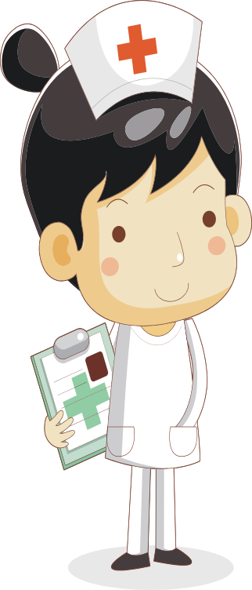
NURSE (p.65)
Nurse Walker’s office is located in the elementary building.
She is there when we need her for headaches and minor illnesses.
If you’re really sick, (fever, throwing up) stay home. If you just don’t want to come to school, come anyway!
If you have medication that needs to be taken at school, it must be given by the nurse. Don’t carry medication in your purse or pocket!

Slide 27



EMERGENCY PROCEDURES
Just as we are practicing our classroom procedures, we need to practice emergency procedures so that we will be prepared if we ever find ourselves in an emergency situation.
We will have practice drills throughout the school year to make sure we know what to do.
Some examples of these events are:
  Fire
  Tornado
  Evacuation
  Lock-down / Intruder
We will do whatever we need to do in order to
keep you safe.

Slide 28

LET’S GET STARTED!

Slide 29

TEXT BOOKS
Put your full name, and 2015-2016 inside the front cover
Make sure your book is covered at all times—it’s the law!
Make note of any damages at the beginning of the year
You will have to pay for any lost or damaged text books at the end of the year

Slide 30

HOW YOUR PAPERS SHOULD LOOK
All assignments written on notebook paper should have:
  Holes on the left
  Complete heading (First and last name, date, subject and section)
  Title
Skip one line to begin assignment
Stay within the margins on BOTH sides of the page
All worksheets should have a complete heading
Work should be completed in pencil or erasable pen only
NO GRAFFITI, NO SCRIBBLES!!!
  Do not draw and doodle on papers to be turned in
  Use your eraser, or draw one line through a mistake

Slide 31




Computer Lab
Sit at your assigned computer.
Always make sure YOU are logged in with your assigned username and password!
Work quietly on your assigned project.
Only go to assigned web sites.
Only print your assigned documents.

Slide 32

READING / WRITING BINDERS
Topics
Compositions
Word Study
Reader’s Notebook
Writer’s Notebook
Daily Work
Tests
Notes / Resources

Slide 33



LIBRARY
As long as you’re quiet, you may sit with anyone. If there’s a problem, I’ll solve it.
Always have a pass, and always sign in at the desk.
Check out books as quickly and quietly as possible, and return to class.
“Do not disturb”

